Slide 1
Express Clothing Co Marketing Analysis
Rachit Arora
John Cottingame
Anoop De
Abhijeet Nayak
Sayali Paseband

Slide 2
Agenda
Introduction
Executive Summary
Customer Breakdown
Market Basket by Segment
Plan for improvement

Slide 3
Executive Summary
Express Clothing Co is currently positioned as a fashion forward clothing brand for young professionals. Whether heading to the board room or for a night on the town Express provides cloths that will make the customer look and feel their best.
Based on our models we have developed a plan which we expect to drive 0.5% additional revenue and 10% direct marketing cost savings over the course of the next year.

Slide 4
Customer Breakdown
Key Take Aways:
Frugal Fiona loves our stores
Professional Paul has marked room for improvement
Executive Ellen has large disposable income but seems to shop only for gifts
Important Goals:
Drive Paul back to the store
Show Ellen she can get more than gifts from us

Slide 5
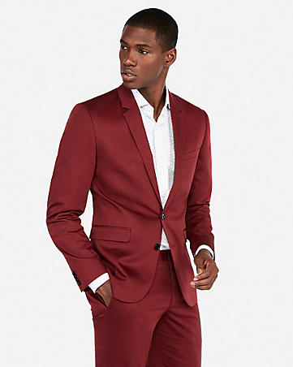
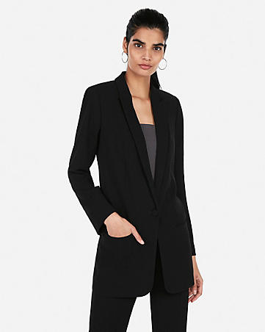
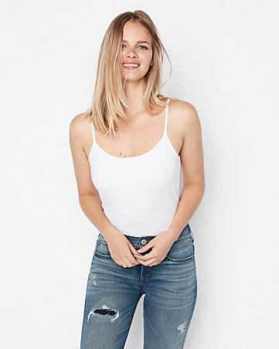


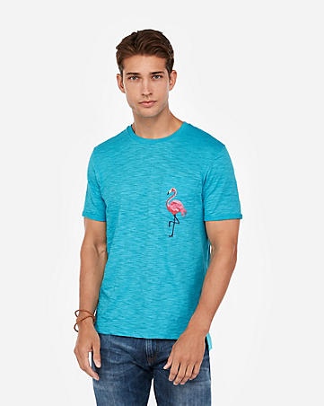
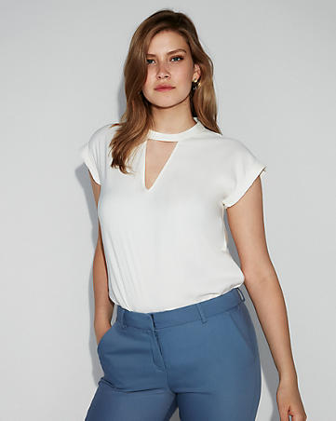
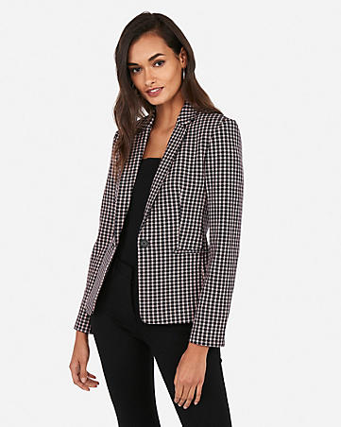
Professional Paul
Mother Mary
Frugal Fiona
Shops Clearance and Sales but is insensitive to price
“Bargain” hunters
Tends to buy only what their family needs
Too busy for coupons
Highly sensitive to price
Proportionally, best performing segment
Springtime Sam
Average Alice
Executive Ellen
Would rather have fun than clip coupons
Fashionable
Segment is performing well
Middle income female shoppers
Uninterested in email promotions or coupons
Under performs

Slide 6
Professional Paul
High income professionals
Current MarCom opportunity
“Bargain” hunters
Does not bother with coupon clipping
Tend to buy only what they need
Mostly men’s clothes
Buy women’s clothes as outfits
Key Insights
Increase Online Marketing
Each additional email advertisement = 0.003% increase in total purchase and reduces time to purchase by 0.41 days
Shops Clearance and Sales but is insensitive to price
Because Paul shops for outfits for his spouse highlight fashionable outfits when advertising women’s clothes to him
Img: www.express.com

Slide 7
Professional Paul Market Basket
 | Professional Paul
 | M_casual_Bottoms | M_Knits | M_Shirts | M_Suits | W_Denims | W_Dress | W_Knit_tops | W_Pants | W_Sweater | W_Woven_T
M_casual_Bottoms |  | -0.33907 | -0.73679 | -0.7089 | -0.5666 | -0.62424 | -0.73886 | -0.65894 | -0.70031 | -0.63017
M_Knits | -0.28136 |  | -0.76984 | -0.8368 | -0.67932 | -0.63973 | -0.62503 | -0.93376 | -0.55425 | -0.69841
M_Shirts | -0.72082 | -0.76941 |  | -0.43718 | -0.7221 | -0.67803 | -0.83249 | -0.70049 | -0.87625 | -0.72157
M_Suits | -0.79247 | -0.87173 | -0.55882 |  | -0.99999 | -0.4914 | -0.68216 | -1 | -0.33502 | -0.66108
W_Denims | -0.57352 | -0.73531 | -0.71705 | -1 |  | -1 | 1.640848 | 1.77958 | -1 | -0.47308
W_Dress | -0.61484 | -0.64145 | -0.66395 | -0.46033 | -0.99999 |  | 0.113157 | 2.637512 | -0.71598 | 0.285824
W_Knit_to | -0.73417 | -0.6411 | -0.82869 | -0.61268 | 2.008074 | 0.039563 |  | -0.3205 | 1.817641 | -0.34962
W_Pants | -0.71418 | -0.94151 | -0.69526 | -1 | 1.610391 | 2.554804 | -0.37293 |  | -0.19523 | 3.977362
W_Sweater | -0.70782 | -0.61015 | -0.87163 | -0.44667 | -1 | -0.70662 | 1.364343 | -0.16848 |  | 0.927261
W_Woven_T | -0.60949 | -0.71487 | -0.69938 | -0.57924 | -0.27072 | 0.251071 | -0.28958 | 4.945294 | 1.704995
Items in Red tend to not be purchased together
Items in Green go hand in hand

Slide 8
Mother Mary
Middle-low income at $45k~
Respond well to email campaigns
No time for coupons
Tends to shop Back-to-school and Fall
Highest online shopper segment
Having kids means buying a variety of products
Key Insights
Tends to buy only what their family needs
Increase targeting during back to school and fall seasons
Img: www.express.com

Slide 9
Mother Mary Market Basket
 | Mother Mary
 | M_casual_Bottoms | M_Knits | M_Shirts | M_Suits | W_Denims | W_Dress | W_Knit_to | W_Pants | W_Sweater | W_Woven_T
M_casual_Bottoms |  | 2.271014 | 0.800744 | -0.7351 | -0.40124 | -0.57023 | -0.71785 | -0.66756 | -0.64428 | -0.85693
M_Knits | 1.982912 |  | 0.632479 | -0.79485 | -0.5929 | -0.93184 | -0.80009 | -0.9003 | -0.67447 | -0.80289
M_Shirts | 0.647403 | 0.579803 |  | 2.60384 | -0.92314 | -0.66912 | -0.88569 | -0.88961 | -0.64299 | -0.69872
M_Suits | -0.68431 | -0.75754 | 1.557167 |  | -0.94086 | -0.87749 | -0.93321 | -0.89885 | -0.92034 | -0.78081
W_Denims | -0.14418 | -0.301 | -0.88132 | -0.86915 |  | -0.71595 | -0.56591 | -0.74045 | -0.61167 | -0.54383
W_Dress | -0.46868 | -0.90605 | -0.45974 | -0.83881 | -0.74897 |  | -0.60052 | -0.84129 | -0.65254 | -0.70091
W_Knit_to | -0.59731 | -0.66129 | -0.8055 | -0.87088 | -0.53219 | -0.50515 |  | -0.7204 | -0.11264 | -0.28588
W_Pants | -0.61959 | -0.86267 | -0.81391 | -0.8033 | -0.74985 | -0.8315 | -0.74698 |  | -0.62465 | -0.48341
W_Sweater | -0.65226 | -0.58951 | -0.55157 | -0.89141 | -0.63647 | -0.62853 | -0.25621 | -0.64199 |  | -0.47957
W_Woven_T | -0.80085 | -0.70058 | -0.44523 | -0.491 | -0.50564 | -0.64467 | -0.32043 | -0.44223 | -0.4162
Items in Red tend to not be purchased together
Items in Green go hand in hand

Slide 10
Frugal Fiona
Low income
Proportionally high revenue generators
Coupon clipper
Large variety of products
Tends to shop in the Fall
Highly sensitive to price
Key Insights
Offering additional coupons is likely to drive repeat business but unlikely to garner additional revenue
Continue as we have been
Img: www.express.com

Slide 11
Frugal Fiona Market Basket
 | Frugal Fiona
 | M_casual_Bottoms | M_Knits | M_Shirts | M_Suits | W_Denims | W_Dress | W_Knit_to | W_Pants | W_Sweater | W_Woven_T
M_casual_Bottoms |  | 1.417901 | 0.27711 | -0.78997 | -0.51896 | -0.63031 | -0.30518 | -0.36587 | -0.25562 | -0.20523
M_Knits | 1.524139 |  | 1.165389 | 0.270868 | -0.38344 | -0.28523 | -0.71703 | -0.37117 | -0.47123 | -0.18763
M_Shirts | 0.180809 | 1.117 |  | 0.053376 | -0.69578 | -0.4351 | -0.56282 | -0.63385 | -0.56695 | -0.75703
M_Suits | -0.69337 | -0.0791 | 0.133829 |  | -0.79638 | -0.78628 | -0.66399 | -0.56027 | -0.78336 | -0.74231
W_Denims | -0.52975 | -0.36014 | -0.70403 | -0.83909 |  | -0.51925 | 0.153845 | -0.04238 | -0.29609 | -0.24475
W_Dress | -0.63919 | -0.26302 | -0.3989 | -0.78682 | -0.55718 |  | 0.480382 | -0.21847 | -0.24738 | -0.19571
W_Knit_to | -0.30809 | -0.73573 | -0.54256 | -0.66023 | 0.2586 | 0.582966 |  | 0.232199 | 0.551 | 1.672194
W_Pants | -0.37948 | -0.34157 | -0.60256 | -0.56591 | -0.11653 | -0.25651 | 0.026444 |  | 0.087194 | 0.233061
W_Sweater | -0.32125 | -0.4757 | -0.56491 | -0.87985 | -0.32908 | -0.26809 | 0.463016 | 0.084154 |  | 0.314557
W_Woven_T | -0.24134 | -0.21987 | -0.76122 | -0.82732 | -0.21541 | -0.13653 | 1.548487 | 0.266301 | -0.56278
Items in Red tend to not be purchased together
Items in Green go hand in hand

Slide 12
Springtime Sam
Spring and Holiday shopper
Wide range of earners
Would rather have fun than clip coupons
Likes to shop with their partner
Trendy, so avoid clearance items
Responds well to MarCom
Key Insights
Focused on buying fashionable outfits
Advertise coordinated items
Men’s ware is highly bundle able
Img: www.express.com

Slide 13
Springtime Sam Market Basket
 | Springtime Sam
 | M_casual_Bottoms | M_Shirts | M_Knits | M_Suits | W_Denims | W_Dress | W_Knit_to | W_Pants | W_Sweater | W_Woven_T
M_casual_Bottoms |  | -0.08762 | 1.376193 | -0.52489 | -0.18625 | -0.73954 | -0.30712 | -0.55745 | -0.50495 | -0.57459
M_Shirts | 5.035138 |  | -0.26251 | -0.53884 | -0.68676 | -0.75968 | -0.63252 | -0.66981 | -0.70052 | -0.69456
M_Knits | -0.40232 | -0.30733 |  | 1.343861 | -0.777 | -0.79499 | -0.78273 | -0.80487 | -0.77508 | -0.6251
M_Suits | -0.97488 | 1.205159 | -0.58992 |  | -0.84317 | -0.67803 | -0.78474 | -0.85039 | -0.59094 | -0.4707
W_Denims | -0.61902 | -0.73313 | -0.64722 | -0.79929 |  | -0.45086 | 0.621254 | -0.14769 | -0.29029 | -0.00209
W_Dress | -0.94234 | -0.77931 | -0.75997 | -0.63308 | -0.4717 |  | 0.208766 | -0.47528 | -0.36447 | -0.34098
W_Knit_to | -0.92013 | -0.74691 | -0.17064 | -0.76181 | 0.731174 | 0.21446 |  | -0.50919 | 0.256588 | 1.188025
W_Pants | 2.494531 | -0.65897 | -0.79018 | -0.82332 | -0.13869 | -0.43943 | -0.54502 |  | 0.02429 | 0.364652
W_Sweater | -0.7898 | -0.70329 | -0.78839 | -0.54411 | -0.29517 | -0.36485 | 0.13145 | -0.02557 |  | -0.2716
W_Woven_T | -0.879 | -0.6619 | -0.59748 | -0.33262 | 0.10495 | -0.30671 | 1.16344 | 0.415666 | -0.19732
Items in Red tend to not be purchased together
Items in Green go hand in hand

Slide 14
Average Alice
Middle Income
Prefers not to use coupons
Avoids the online shop
Shop 85% women’s clothes
Buys a variety of outfits
Key Insights
Segment is performing well
Img: www.express.com

Slide 15
Average Alive Market Basket
 | Average Alice
 | M_casual_Bottoms | M_Shirts | M_Knits | M_Suits | W_Denims | W_Dress | W_Knit_to | W_Pants | W_Sweater | W_Woven_T
M_casual_Bottoms |  | -0.11759 | 2.495929 | 0.809408 | -0.47387 | -0.76236 | -0.53069 | -0.62469 | -0.64256 | -0.64438
M_Shirts | 0.002864 |  | 0.984366 | -0.69929 | -0.54493 | -0.70281 | -0.8054 | -0.71183 | -0.6245 | -0.74426
M_Knits | 2.798473 | 0.968161 |  | 5.484396 | -0.73236 | -0.63861 | -0.79295 | -0.6747 | -0.565 | -0.65382
M_Suits | 0.831984 | 4.827562 | -0.76583 |  | -0.86031 | -0.74265 | -0.45714 | -0.36752 | -0.74681 | -0.53948
W_Denims | -0.34773 | -0.67505 | -0.50919 | -0.88757 |  | -0.53888 | -0.04591 | -0.42149 | -0.24301 | -0.59432
W_Dress | -0.67352 | -0.54219 | -0.64541 | -0.5841 | -0.53782 |  | -0.26853 | -0.47523 | -0.54109 | -0.43881
W_Knit_to | -0.71714 | -0.71945 | -0.37712 | -0.07504 | 0.005455 | -0.23624 |  | -0.37587 | -0.06872 | -0.20403
W_Pants | -0.49616 | -0.6464 | -0.60072 | -0.12742 | -0.41684 | -0.47276 | -0.41421 |  | -0.33675 | -0.22143
W_Sweater | -0.56027 | -0.55139 | -0.48066 | -0.69711 | -0.23921 | -0.54393 | -0.14615 | -0.34433 |  | -0.43283
W_Woven_T | -0.47265 | -0.65709 | -0.58372 | -0.48346 | -0.57848 | -0.41725 | -0.20911 | -0.18004 | -0.38335
Items in Red tend to not be purchased together
Items in Green go hand in hand

Slide 16
Executive Ellen
Upper income
Low spend
MarCom opportunity
Uninterested in email promotions or coupons
Holiday Shopper
Insights
Responds well to mailed marketing
Dislikes receiving email advertising
Not price sensitive except in regard to Men’s clothing which they buy as outfits
Img: www.express.com

Slide 17
Executive Ellen Market Basket
 | Executive Ellen
 | M_casual_Bottoms | M_Shirts | M_Knits | M_Suits | W_Denims | W_Dress | W_Knit_to | W_Pants | W_Sweater | W_Woven_T
M_casual_Bottoms |  | -0.26501 | 0.25345 | -0.80753 | -0.66859 | -0.76404 | -0.77541 | -0.96243 | -0.61546 | -0.82065
M_Shirts | -0.20808 |  | 0.769151 | -0.79622 | -0.48588 | -0.81267 | -0.96219 | -0.80546 | -0.70231 | -0.86464
M_Knits | 0.71292 | 1.23446 |  | 1.497023 | -0.83229 | -0.83757 | -0.93284 | -0.57696 | -0.74643 | -0.73734
M_Suits | -0.6948 | 1.152865 | -0.75372 |  | -0.90108 | -0.9434 | -0.87579 | -0.85168 | -0.52546 | -0.74751
W_Denims | -0.18535 | -0.68973 | -0.49419 | -0.83128 |  | -0.77902 | -0.70406 | -0.56434 | -0.37537 | -0.64281
W_Dress | -0.63035 | -0.75394 | -0.66749 | -0.88751 | -0.76669 |  | -0.69578 | -0.73993 | -0.64092 | -0.63662
W_Knit_to | -0.93949 | -0.88426 | -0.52069 | -0.66756 | -0.66264 | -0.6731 |  | -0.63377 | -0.24542 | -0.62853
W_Pants | -0.95664 | -0.7347 | -0.62023 | -0.67803 | -0.56725 | -0.73933 | -0.58625 |  | -0.4542 | -0.3867
W_Sweater | -0.84687 | -0.89441 | -0.67192 | -0.70852 | -0.57365 | -0.70803 | -0.36046 | -0.72141 |  | -0.76418
W_Woven_T | -0.66284 | -0.77896 | -0.64516 | -0.56482 | -0.59221 | -0.62228 | -0.37917 | -0.3245 | -0.07392
Items in Red tend to not be purchased together
Items in Green go hand in hand

Slide 18
Path to Success
Actions – Executive Ellen
Increase direct mail marketing by 25%
Advertise men’s ware as a bundle
Expected return = 2% on segment sales
Expected cost impact = 3.1% increase in direct mail budget
Assuming $2 direct mail cost this is an overall 36% ROI for direct mail investment
Actions – Professional Paul
Increase email marketing to Professional Paul by 25% or 20 emails per year
Include coupons on women’s clothes
Expected return = 1.4% on segment
Reduce direct mail to near zero
Expected cost impact = 13% direct mail cost savings
Notes:
Professional Paul
Sending emails increases purchase and reduces time to purchase
Tend to buy outfits in women’s cloths
Accounts for 13% of direct mail marketing spend
Segment 1 = 1756 individuals * 2.6(average mail per year) / 33176 total direct mails

Slide 19
Test and Learn

